Slide 1
Capstone Project
Employee Attrition
By:
Jothilakshmi @ Indu

Slide 2
INTRODUCTION
Today, occupational diseases that have been triggered by an occupational accident are commonly accepted and recognized. However, there are a series of psychosocial factors that can cause excessive emotional or cognitive demands on workers as a result of the subject perceiving that this interaction with their environment is beyond the control of the repertoire of their coping strategies.
Faced with this situation, it can respond with a range of cognitive-behavioral reactions that are in three dimensions (low self-efficacy, emotional exhaustion and depersonalization) that will trigger the disease called "burnout" or "syndrome of burned by work."
This disease can cause serious problems for the company, being workplace accidents, external and internal rotations, decreased productivity and interpersonal problems, the most widespread.

Slide 3

OBTECTIVES
The objective of this project is to develop a classification algorithm with a roc auc curve and a confusion matrix that are efficient enough to detect, through a secondary intervention, following certain variables, those employees who may develop the syndrome of burnout in the near future.

Slide 4
FEATURES
Here we have done the basic exploration and cleaning of the dataset
We also make the overall summary of Exploratory Data Analysis (EDA).
Then we done data preprocessing, the main goal of data preprocessing is to improve the quality of the data and to make it more suitable for the specific data mining task.
For the employee attrition problem, we have selected a diverse set of classifiers to explore different modeling approaches and capture various aspects of the data.
Finally, Hyperparameter plays an essential role in the fitting of supervised machine learning algorithms. However, it is computationally expensive to tune all the tunable hyperparameters simultaneously especially for large data sets.

Slide 5
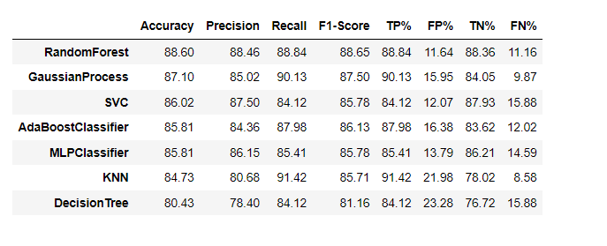
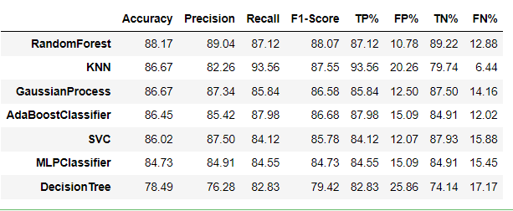
Comparing Tuned Models with Base Models
Base Models
Tuned Models

Slide 6
CONCLUTION
Based on the provided results, it appears that the Hyperparameter Tuned Models generally the same as Base Models in terms of accuracy across different evaluation metrics (accuracy, precision, recall, F1-score). The Hyperparameter Tuned Models have approximately accuracy, precision, and F1-score compared to the Base Models for most classifiers.
The top-performing models in both the Base and Hyperparameter Tuned categories is RandomForest. In the Base Models, RandomForest achieves the highest accuracy, while in the Hyperparameter Tuned Models, RandomForest achieves the highest accuracy.
Even through It is worth noting that the improvement in accuracy and other metrics between the Base and Hyperparameter Tuned Models varies across classifiers. Some classifiers, like DecisionTree and KNN, show a substantial improvement in accuracy through hyperparameter tuning, while others, like GaussianProcess and MLPClassifier, show only marginal improvements.

